Slide 1




AGENDA
Confusion Matrix for Multi-Class Classification

Slide 2
What Is a Confusion Matrix?
A confusion matrix is a visualization tool that helps in understanding the performance of a classification model. It’s a table that summarizes the predictions made by a model against the actual ground truth values.
It is used for the optimization of machine learning models.
The confusion matrix is a N x N matrix, where N is the number of classes or outputs.
For 2 classes, we get a 2 x 2 confusion matrix.
For 3 classes, we get a 3 X 3 confusion matrix.

Slide 3
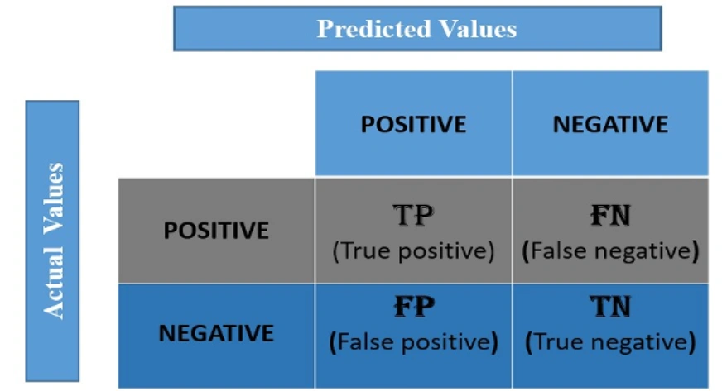
How to Create a 2X2 Confusion Matrix?

Slide 4
What Is a Confusion Matrix?
There are 4 terms you must understand in order to correctly interpret or read a Confusion Matrix:
True Positive(TP)
False Positive(FP)
True Negative(TN)
False Negative(FN)

Slide 5
What Is a Confusion Matrix?
There are 4 terms you must understand in order to correctly interpret or read a Confusion Matrix:
True Positive(TP)
False Positive(FP)
True Negative(TN)
False Negative(FN)

Slide 6
Confusion Matrix for Binary Classification Example
Binary classification has 2 outputs. The inputs for this classification will fall in either of the 2 outputs or classes

Slide 7
Confusion Matrix for Binary Classification Example
Consider we have to model a classifier that classifies 2 kinds of fruits.
We have 2 types of fruits –
apples and grapes –
and we want our machine-learning model to identify or classify the given fruit as an apple or grape.

Slide 8
Confusion Matrix for Binary Classification Example
So we take 15 samples of 2 fruits,
out of which 8 belong to Apples,
and 7 belong to the Grapes class.
Class is nothing but the output,
in this example, we have 2 output classes – Apples and Grapes. We will represent Apple as 1 and Grape as 0 class.

Slide 9
Confusion Matrix for Binary Classification Example
The actual class for 8 apples and 7 grapes can be represented as:
Actual = [1,1,1,1,1,1,1,1,0,0,0,0,0,0,0]
The classifier model predicts 1 for Apple and 0 for grape.

Slide 10
Confusion Matrix for Binary Classification Example
Assume that the classifier takes all 15 inputs and makes the following predictions:
Out of 8 apples, it will classify 5 correctly as apples and wrongly predict 3 as grapes.
Out of 7 grapes, it will classify 5 correctly as grapes and wrongly predicts 2 as apples
The prediction of the classifier may be as follows:
Prediction = [1,0,0,0,1,1,1,1,0,0,0,0,0,1,1]

Slide 11
Confusion Matrix for Binary Classification Example
The actual class for 8 apples and 7 grapes can be represented as:
Actual = [1,1,1,1,1,1,1,1,0,0,0,0,0,0,0]
The prediction of the classifier may be as follows:
Prediction = [1,0,0,0,1,1,1,1,0,0,0,0,0,1,1]

Slide 12
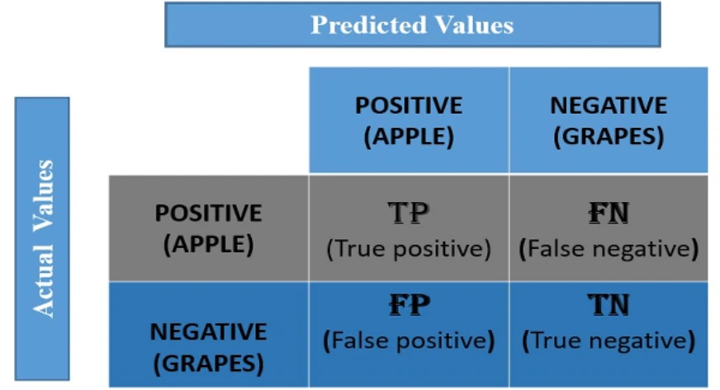
Confusion Matrix for Binary Classification Example

Slide 13
Confusion Matrix for Binary Classification Example
True Positive: It means the actual value and the predicted values are the same.
True Negative: It means the actual value and the predicted values are the same.

Slide 14
Confusion Matrix for Binary Classification Example
False Negative: This means the actual value is positive. but the model has predicted it as negative. So whatever the negative output we got is false; hence the name False Negative.
False Positive: This means the actual value is negative. but the model has predicted it as positive. so whatever the positive output we got is false, hence the name False Positive.

Slide 15
Classification Report
Sklearn classification_report() outputs precision, recall, and f1-score for each target class. In addition to this, it also has some extra values: micro avg, macro avg, and weighted avg.
Mirco average is the precision/recall/f1-score calculated for all the classes.
Macro average is the average of precision/recall/f1-score.
Weighted average is just the weighted average of precision/recall/f1-score.

Slide 16
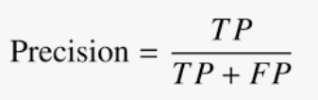
Classification Report
Precision
Layman definition: Of all the positive predictions I made, how many of them are truly positive?
Calculation: Number of True Positives (TP) divided by the Total Number of True Positives (TP) and False Positives (FP).

Slide 17

Classification Report
Recall
Layman definition: Of all the actual positive examples out there, how many of them did I correctly predict to be positive?
Calculation: Number of True Positives (TP) divided by the Total Number of True Positives (TP) and False Negatives (FN).

Slide 18

Classification Report
F1 Score
To evaluate model performance comprehensively, we should examine both precision and recall. The F1 score serves as a helpful metric that considers both of them.
Definition: Harmonic mean of precision and recall for a more balanced summarization of model performance.
Calculation:

Slide 19
Classification Report
F1 Score
To evaluate model performance comprehensively, we should examine both precision and recall. The F1 score serves as a helpful metric that considers both of them.
Definition: Harmonic mean of precision and recall for a more balanced summarization of model performance.
Calculation:

